Slide 1
Gender Prediction from Anthropometric Data
Capstone Project Report
(EDA + Statistical Analysis + Machine Learning)

Slide 2
Abstract
This project investigates gender prediction using anthropometric data.
EDA revealed differences between male and female groups.
Random Forest achieved 100% accuracy.

Slide 3
Dataset Description
- NHANES 2020 dataset
- Features: Weight, Height, Waist, Hip, BMI
- Target: Gender

Slide 4
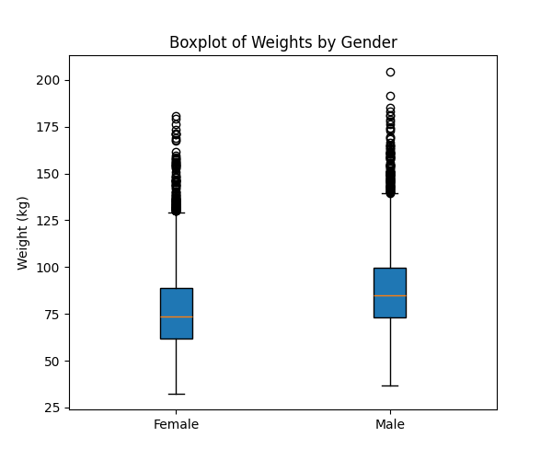
Exploratory Data Analysis (EDA)
- Weight distributions compared
- Females had higher waist-to-height ratios
- Males showed greater variance in weight

Slide 5
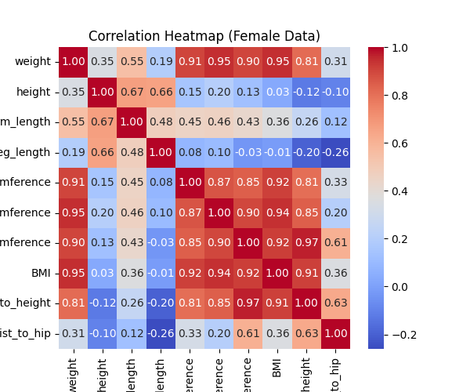
Correlation Analysis
- Strong correlations: Weight, Waist, Hip, BMI
- Heatmaps confirmed associations for both genders

Slide 6
Statistical Testing
- Independent t-tests used
- Significant differences in most features (p < 0.05)
- Strong evidence of sexual dimorphism

Slide 7
Machine Learning Models
- Logistic Regression
- Support Vector Machine (SVM)
- Random Forest (Best performing)

Slide 8
Model Performance
Logistic Regression: Acc 94.3%
SVM: Acc 94.2%
Random Forest: Acc 100%
RF achieved perfect classification

Slide 9
Conclusion
- Anthropometric features predict gender strongly
- Random Forest best model
- LR and SVM also reliable

Slide 10
Future Work & Limitations
- Use more diverse datasets
- Add features like body fat %
- Try Deep Learning
- Ethical concerns (privacy)

Slide 11
References
1. NHANES Dataset (CDC)
2. Scikit-learn Docs
3. Seaborn & Matplotlib Docs
4. python-docx & ReportLab

